Slide 1
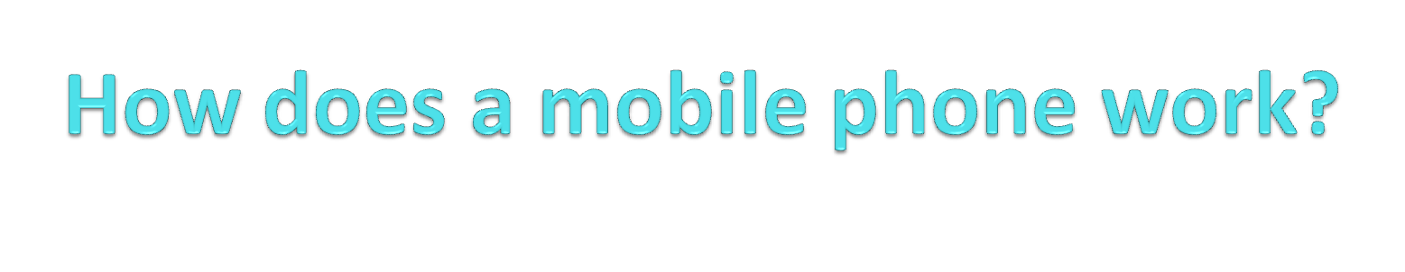
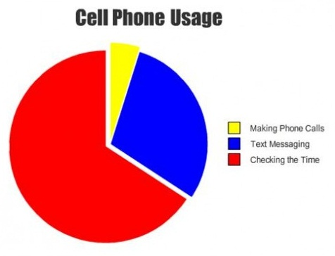
Murtaza Jafferji

Slide 2
Cell phone?
A cell phones works as a two way radio which sends as well as receives signals with a cellular network of base stations known as cell sites.
There aren’t any wires! How does it make a call?!...

Slide 3
Complicated Version

Slide 4
1) User dials a number
When placing a mobile originated call, the dialed digits are keyed in. The mobile does not transmit at this time. This process is called preorigination dialing and the dialed digits are put into memory. The call process starts when the user presses the SEND key.

Slide 5
2) Phone scans for access channel
After the SEND key is pressed, the mobile scans the 21 dedicated control channels looking for an access channel.
  Each carrier (non-wireline, wireline) has 21 channels allocated for control purposes. One of these channels is assigned to each cell site. A control channel is on the air 24 hours a day, 365 days a year. The control channel actually combines three functions into one channel:
    control information (signalling)
    paging
    access

Slide 6
3) Phone transmits service request
When the mobile locks onto what it recognizes as an access channel it checks the status of the busy/idle bits on the FOCC. A “0" indicates the REVCC is busy processing a call. A "1" indicates the channel is available for use. When the mobile sees a "1" status, it transmits a service request on the REVCC.
  Signaling information sent to the mobile is on the Forward Control Channel (FOCC).
  Signaling information sent to the cell site is on the Reverse Control Channel (REVCC).

Slide 7
4) Wait for command from cell site
The service request contains the mobile's ESN, dialed digits, and its directory number.
  Electronic Serial Number(ESN). This number is unique to each mobile.
If the channel is available, the mobile waits for a command from the cell site.

Slide 8
5) Cell site forwards info to MSC
When the cell site receives the service request message, it forwards the information to the MSC(Mobile Switching Center).
  The MSC validates the subscriber's MIN (phone number) and ESN and translates or routes the call.

Slide 9
6) Cell site transmits IVCDM to mobile
The cell site selects an idle voice channel and transmits an Initial Voice Channel Designation Message (IVCDM) to the mobile.
  The IVCDM contains the voice channel number and the associated Supervisory Audio Tone (SAT) for the mobile to transmit.
    The SAT acts as a safeguard against co-channel interference.

Slide 10
7) Info sent to either PSTN or MSC
After validation and translation, the dialed digit information is sent to the…
  PSTN for landlines.
    PSTN (Public Switched Telephone Network)
  MSC for cell phones.
    MSC (Mobile Switching Center)

Slide 11
8) Hearing ringback and conversation begins
When the cell site detects the transmitted SAT from the mobile it knows the mobile is on the assigned voice channel. Both audio paths are enabled and the mobile user hears ringback from the PSTN/MSC. When the called party answers conversation begins.

Slide 12
Simplified Version

Slide 13
1) User enters a phone number and presses SEND

Slide 14
2) Phone transmits that telephone number, along with a request for service signal, and all the information used to register a call to the cell site.
The mobile transmits this information on the strongest REVCC (reverse control channel…signaling information sent from phone to the cell site is sent on here).

Slide 15
3) The MSC (Mobile Switching Center) checks out this info and assigns a voice channel.
It communicates that assignment to the mobile on the FOCC (forward control channel…signaling information sent from the cell site to the mobile is on here).

Slide 16
4) The cell site opens a voice channel and transmits a SAT on it.
  Supervisory Audio Tone (SAT)
    The SAT acts as a safeguard against co-channel interference.

Slide 17
5) The mobile detects the SAT and locks on, transmitting it back to the cell site (as confirmation).

Slide 18
6) The MSC detects this confirmation and sends the mobile a message in return.
This could be several things. It might be a busy signal, ringback, or whatever tone was delivered to the switch.

Slide 19
7) When the called party answers conversation begins.

Slide 20
Summary
When you talk on a cell phone the voice messages in it gets converted into the radio waves and these waves travel through the air to reach the close by base station.
From these base stations the calls are sent across the communication network and finally reach the receiver of the call.
The base station which is located near to the called number sends the radio waves so that the receiver device can detect them and finally the cell phone of the receiver converts these signals into voice and call takes a place.

Slide 21
Magic
The majority of the cell phones use the digital technology that coverts your voice into form of binary digits 0 and 1 and these data packets are relayed through the wireless networks of the receiving phone.

Slide 22
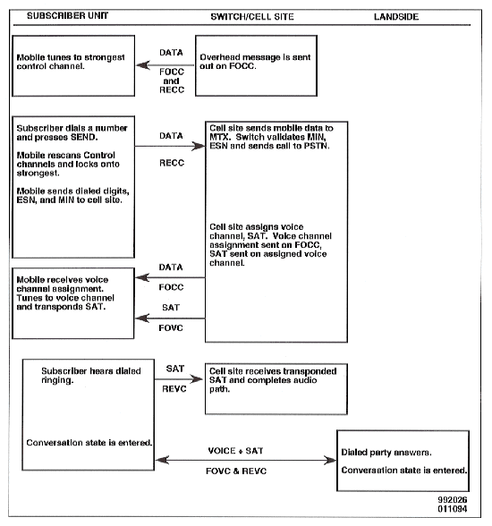

Slide 23
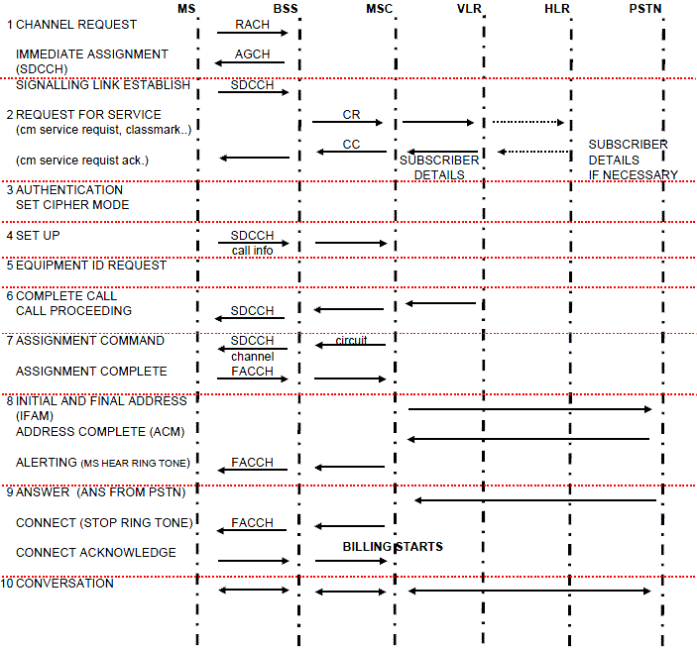

Slide 24
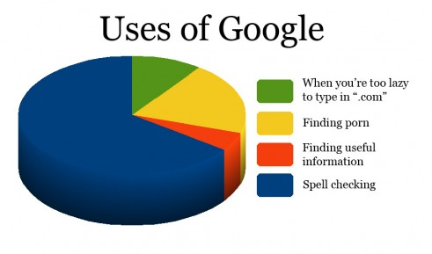
Funny thing I found while making this presentation

